Slide 1
Life tables, Survival curves, and Kaplan-Meier survival curves
Weber Liu

Slide 2
Contents
Survival data
Censored data
Organising your survival data
Life tables
Survival curves
Kaplan-Meier survival curves

Slide 3
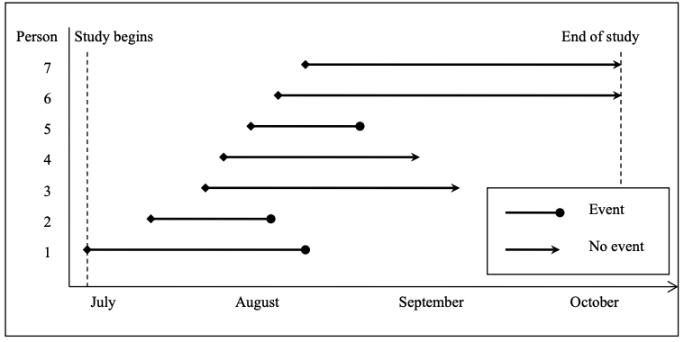
Survival data
Time-to-event data
Start time: Time of entry to trial, Time of randomization, Time of diagnosis
Event – “Outcome”, “Endpoint”
Post-diagnosis: Death
Cancer: Metastasis, local recurrence
Birth: Breast-feeding cessation
Hip injury: Hospital readmission
The time between ’start time’ and ‘endpoint’ is the time each patient is ’at risk’
This is also called the ‘serial time’
i.e. They are ‘at risk’ the moment the enter the study, until they leave the study
Notes:
In this figure, imagine we had a study looking at people who were X
Patient 1, 2 and 5 had the event
Patient 3 – moved overseas, and so we do NOT know if they had the event after leaving the country
Patient 4 – Withdrew from the study (i.e. lost to follow-up) – we do not know if they had an event after withdrawal
Patient 6 and 7 were involved in the study to the end, and didn’t have any issues at the end of the study.

Slide 4
Censored observations
In our previous example, only 3 people had events – however the data collected from the other 4 people were still useful
It indicates that these people were AT RISK, but didn’t develop the outcome – this is still informative
Observations which should be censored include:
Person lost to follow-up
Person withdrew from study, or
Person had not experienced events by the study end point
A general rule of thumb is – if you are NOT sure they’ve developed the outcome at the point of leaving/ending, they are censored.
Survival times (days):
35, 25, 40*, 30*, 20, 60*, 55*
(*) = censored data
Notes:
In the previous figure, patients 3, 4, 6 and 7 would therefore be censored.
Make a point of how these are the populations in the study that need to be considered as ‘censored’!

Slide 5
Practical approach to survival analysis
Step 1: Prepare your data
Step 2: Run your code

Slide 6
Step 1: Organising survival time data (Example)
Say you started with the following data:
Survival time (in years) of 20 patients after diagnosis of parathyroid cancer
Notice that this data is discrete rather than continuous
Still alive (years) | Deaths (years)
<1 | <1
<1 | 2
1 | 6
1 | 6
4 | 7
5 | 9
6 | 9
8 | 11
10 | 14
10
17

Slide 7
Step 1: Organising survival time data (Example)
Data should be organized into tables that look like the following
Serial time (units) | Status/Censor (0 = censored, 1 = event)
<1 | 0
<1 | 0
<1 | 1
1 | 0
1 | 0
2 | 1
4 | 0
5 | 0
6 | 0
6 | 1
6 | 1
7 | 1
8 | 0
9 | 1
9 | 1
10 | 0
10 | 0
11 | 1
14 | 1
17 | 0
Serial time (units) | Status/Censor (0 = censored, 1 = event) | Group
<1 | 0 | No drug
<1 | 0 | No drug
<1 | 1 | No drug
1 | 0 | Drug dose10mg
1 | 0 | Drug dose 15mg
2 | 1 | No drug
4 | 0 | Drug dose 10mg
5 | 0 | Drug dose 10mg
6 | 0 | No drug
6 | 1 | No drug
6 | 1 | No drug
7 | 1 | No drug
8 | 0 | Drug dose 10mg
9 | 1 | Drug dose 15mg
9 | 1 | Drug dose 15mg
10 | 0 | Drug dose 10mg
10 | 0 | Drug dose 15mg
11 | 1 | Drug dose 15mg
14 | 1 | No drug
17 | 0 | Drug dose 10mg
Serial time (units) | Status/Censor (0 = censored, 1 = event) | Drug_group | Medical_hx_group
<1 | 0 | No drug | Diabetes
<1 | 0 | No drug | Diabetes
<1 | 1 | No drug | None
1 | 0 | Drug dose10mg | Diabetes
1 | 0 | Drug dose 15mg | None
2 | 1 | No drug | None
4 | 0 | Drug dose 10mg | Diabetes
5 | 0 | Drug dose 10mg | Diabetes
6 | 0 | No drug | None
6 | 1 | No drug | None
6 | 1 | No drug | Diabetes
7 | 1 | No drug | Diabetes
8 | 0 | Drug dose 10mg | Diabetes
9 | 1 | Drug dose 15mg | None
9 | 1 | Drug dose 15mg | None
10 | 0 | Drug dose 10mg | Diabetes
10 | 0 | Drug dose 15mg | Diabetes
11 | 1 | Drug dose 15mg | None
14 | 1 | No drug | Diabetes
17 | 0 | Drug dose 10mg | None
We generally use group if there are subgroups within the population or trial arms (i.e. each group is a different survival curve you might want to plot/compare) In this example, everyone is in the same group
Serial time is the amount of time between patient entry and patient outcome/censor
Status/censor at serial time – this is binary, where 0 USUALLY indicates a patient is censored, 1 USUALLY indicates that a patient has experienced the outcome/endpoint

Slide 8
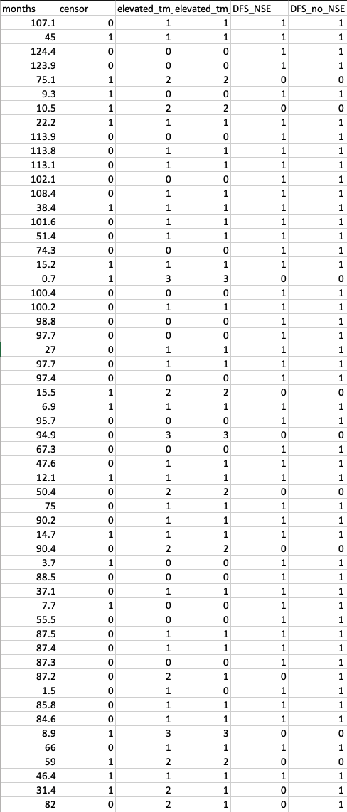
Step 1: Organising survival time data (Case study)
An example of how I re-organized the data from the study
Each row is a patient/participant
‘months’ column is the serial time
‘censor’ column is whether or not patient was censored or experienced outcome
As per convention:
0 indicates censored
1 indicates event experienced
elevated_tm_all is the number of elevated tumour markers for each patient
The values it can take are an integer number of elevated tumour markers per patient
I’ve saved this data as ‘.csv’ with UTF-8 formatting, but saving it as a .xlsx document also works (just requires different ways of importing)

Slide 9
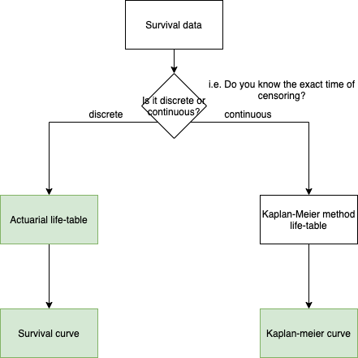
Time-to-event data representations
Life tables
Actuarial life tables can be used for discrete data
Our example (previous slides) are examples of discrete data
Kaplan-Meier method life tables can be used for continuous-time data but typically not presented as it contains many rows and too much data
Survival curve
Suitable for discrete data - i.e. when we do NOT know when the exact time of censoring/endpoint are known
A graph of cumulative survival probability from the actuarial life table
Kaplan-Meier curves/estimator
Suitable for continuous-time data
Kaplan Meier curves can be constructed by hand from the cumulative survival proportion column in the Kapan-Meier method life table
Green = you can present this in your report

Slide 10
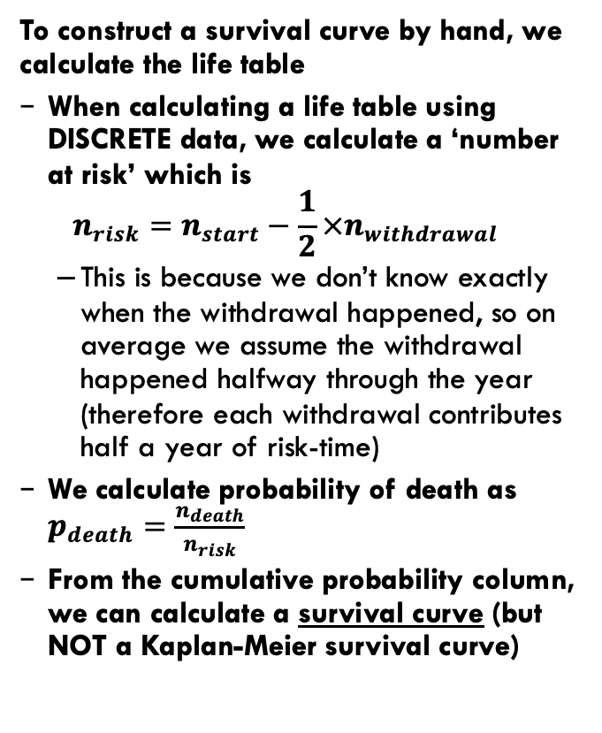
The principle behind an actuarial life-table (FOR DISCRETE DATA)
To construct a survival curve by hand, we calculate the life table
When calculating a life table using DISCRETE data, we calculate a ‘number at risk’ which is ${n_{risk}=n}_{start}−\frac{1}{2}×n_{withdrawal}$
This is because we don’t know exactly when the withdrawal happened, so on average we assume the withdrawal happened halfway through the year (therefore each withdrawal contributes half a year of risk-time)
We calculate probability of death as $p_{death}=\frac{n_{death}}{n_{risk}}$
From the cumulative probability column, we can calculate a survival curve (but NOT a Kaplan-Meier survival curve)
Year | Number at start | Withdrawal during year | Number at risk | Deaths | Probability of death | Probability of surviving year x | Cumulative probability of surviving x years
1 | 20 | 2 | 19 | 1 | 0.05 | 0.95 | 0.947
2 | 17 | 2 | 16 | 0 | 0.00 | 1.00 | 0.947
3 | 15 | 0 | 15 | 1 | 0.07 | 0.93 | 0.884
4 | 14 | 0 | 14 | 0 | 0.00 | 1.00 | 0.884
5 | 14 | 1 | 13.5 | 0 | 0.00 | 1.00 | 0.884
6 | 13 | 1 | 12.5 | 0 | 0.00 | 1.00 | 0.884
7 | 12 | 1 | 11.5 | 2 | 0.17 | 0.83 | 0.730
8 | 9 | 0 | 9 | 1 | 0.11 | 0.89 | 0.649
9 | 8 | 1 | 7.5 | 0 | 0.00 | 1.00 | 0.649
10 | 7 | 0 | 7 | 2 | 0.29 | 0.71 | 0.464
11 | 5 | 2 | 4 | 0 | 0.00 | 1.00 | 0.464
12 | 3 | 0 | 3 | 1 | 0.33 | 0.67 | 0.309
13 | 2 | 0 | 2 | 0 | 0.00 | 1.00 | 0.309
14 | 2 | 0 | 2 | 0 | 0.00 | 1.00 | 0.309
15 | 2 | 0 | 2 | 1 | 0.50 | 0.50 | 0.155
16 | 1 | 0 | 1 | 0 | 0.00 | 1.00 | 0.155
17 | 1 | 0 | 1 | 0 | 0.00 | 1.00 | 0.155
18 | 1 | 1 | 0.5 | 0 | 0.00 | 1.00 | 0.155

Slide 11
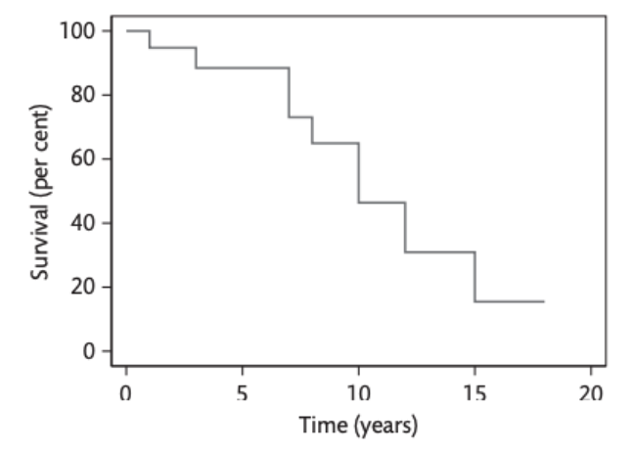
The principle behind a SURVIVAL CURVE (DISCRETE DATA)
Plotting cumulative survival vs. time in excel will produce the survival curve
However note a few errors with this curve:
The lines in a survival curve should purely be either horizontal or vertical (e.g. t = 1, line should go horizontally down)
There shouldn’t be dots on the curve
Other notes
Survival curves tend to not include markers for when data is censored
When more events are censored, a death of 1 patient results in a bigger drop in the survival curve
Takeaways
Don’t use excel to make a survival curve

Slide 12

Case study: The principle behind a life-table (FOR CONTINUOUS DATA)
To construct a K-M survival curve by hand, we can ALSO calculate a life table
Time (months) | Alive at start | Number died | Number censored | Probability of death | Probability of survival | Percentage of survivors at end of day
0 | 107 | 107 | 0 | 0 | 0 | 100
0.7 | 107 | 1 | 0 | 0.00934579 | 0.99065421 | 99.0654206
1.5 | 106 | 0 | 1 | 0 | 1 | 99.0654206
2.00 | 105 | 1 | 0 | 0.00952381 | 0.99047619 | 98.1219404
3.7 | 104 | 1 | 0 | 0.00961538 | 0.99038462 | 97.1784602
5.9 | 103 | 0 | 1 | 0 | 1 | 97.1784602
Each time value is the next ‘time’ point something of interest occurs
Probability of death is equal to:
% survivors is equal to:
‘Alive at start’ is the number of alive people from the previous time point minus the number who have died OR have been censored
$${p_{death}}_{x}=\frac{{n_{died}}_{x}}{{n_{alive}}_{x}}$$
$$\%survival_{x}=\%survival_{x−1}×{P_{survival}}_{x}$$
Probability of survival is equal to:
$$n_{alive_{x}}=n_{alive_{x−1}}−{n_{died}}_{x−1}−{n_{censored}}_{x−1}$$
$${P_{survival}}_{x}=1−{P_{death}}_{x}$$
Notes:
Notice that the probability of death here is actually calculated from number died / number alive (rather than number at risk) – as we have exact dates and times of censoring we do not need to guess
Note that the ‘time’ is no longer in discrete values – they are the times in which either a death/censor event occurs.
This is also not the continuous data because its way too long

Slide 13
Case study: The principle behind a Kaplan-Meier survival curve (CONTINUOUS DATA)
Try this for yourself – already completed in the page ‘K-M by hand’ in the included excel file – plot out the cumulative survival vs. serial time
Obviously do not use excel and manually calculate K-M for your report…
When using continuous data, we put ‘tickers’ for each censoring event
Notes:
When using continuous data, we put markers on

Slide 14
Step 2: Creating a life-table in R
> # Load libraries for survival analysis
> library(survival)
> # Load data from file
> cancer <- read.csv("./cancerdata.csv")
> # Fit the data to a survival model
> surv_table.cancer <- survfit(Surv(months, censor) ~ 1, conf.type = "none", data = cancer)
> # Report life-table
> summary(surv_table.cancer)
Step 3: Plotting the survival curve in R
> # Plot the survival curve
> plot(surv_table.cancer, xlab = "Months", lty=1, ylab = "Survival probability", mark.time=TRUE)

Slide 15
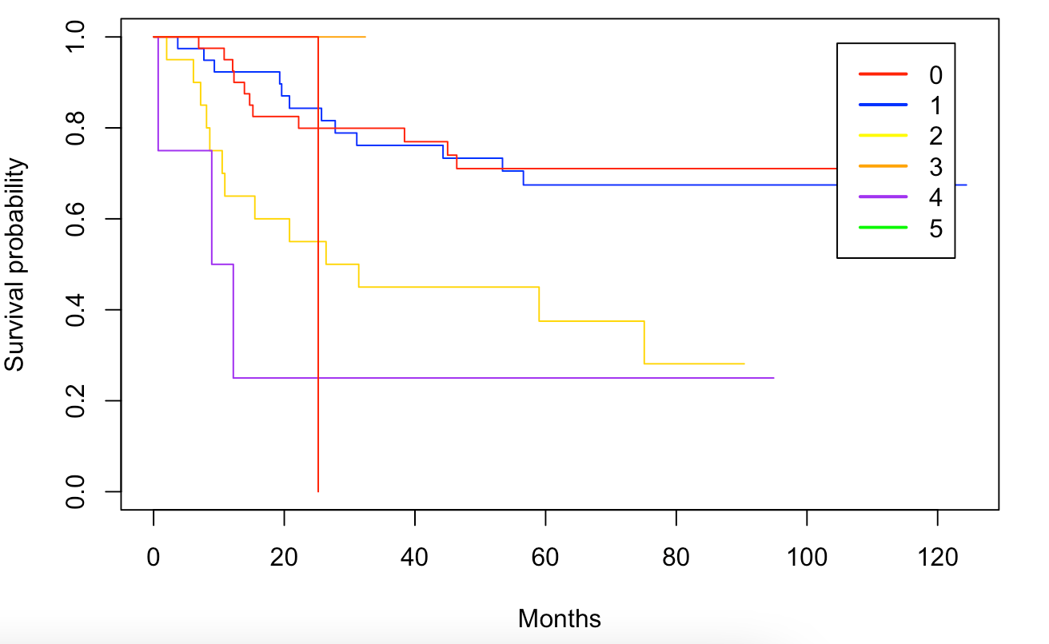
Plotting K-M curves by different strata
Simply requires an extra step of splitting the data into multiple datasets based on the strata
E.g. if our patients have 1-0 positive tumour markers, place them into dataset 1; if our patient has >=2 positive tumour markers, place them into dataset 2
This is why we use the ‘groups’ column in our ordered data.
Step 4: Plotting K-M curves by strata in R
> surv_table.cancer <- survfit(Surv(months, censor) ~ elevated_tm_all, data=cancer, conf.type="log-log")
> # Plot figure
> plot(surv_table.cancer, xlab="Months", lty=1, col=c("red", "blue", "black", "orange", "purple", "green"), ylab="Survival probability")
> legend("topright", inset=0.05,
c("0", "1", "2", "3", "4", "5"),
col=c("red", "blue", "yellow", "orange", "purple", "green"),
lty=1,
lwd=2,
cex=1)

Slide 16
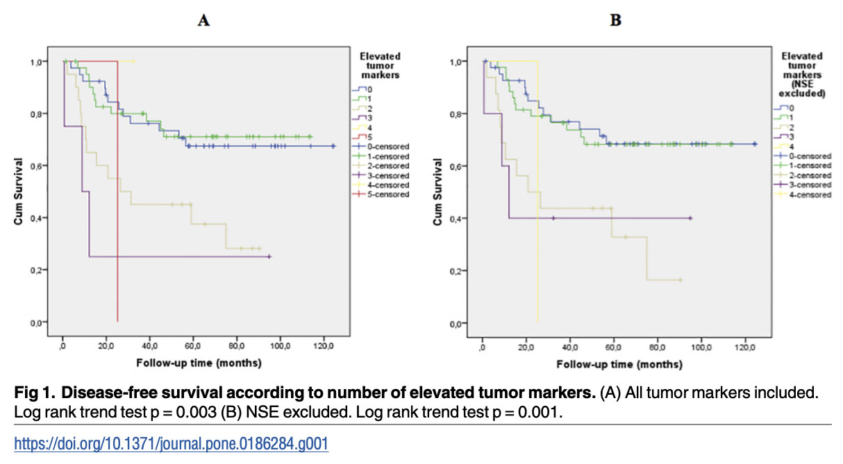
Case study: Survival curve by strata (elevated tumour markers)
Method: “Disease-free survival (DFS) was estimated by the Kaplan-Meier curves and two-sided log-rank tests or log rank trend test were used to compare survival curves.”
Results: “Survival analysis according to number of elevated tumor markers using DFS as endpoint showed an association of worse prognosis with increasing number of positive tumor markers at time of diagnosis (Fig 1).”
https://journals.plos.org/plosone/article/figure?id=10.1371/journal.pone.0186284.g001
Notes:
Putting survival curves

Slide 17
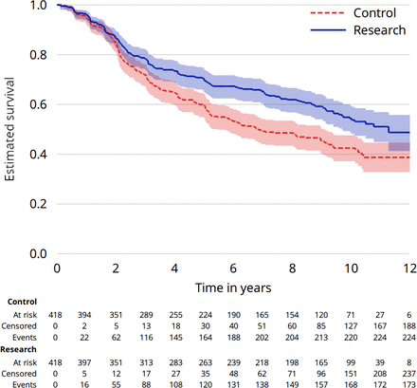
What other things do you tend to find in a Kaplan-Meier survival curve?
Note these are NOT typically presented in medical research but they are the least ambiguous versions
Confidence intervals (shadows) can indicate how many participants are in the study – larger confidence intervals indicate less patients (could indicate large dropout rates)
Number at risk table is sometimes included, and indicates the number of patients at risk, and cumulative number censored at each major time point ticker.
Both are available in the survminer package in R
https://bmjopen.bmj.com/content/9/9/e030215

